Slide 1
Using r
Descriptive Statistics
and Tabulation

Slide 2
Summary Commands
An essential starting point with any set of data is to get an overview of what you are dealing with. There are a few ways to go about doing this. You might start by using the ls() command to see what named objects you have. You can then type the name of one of the objects to view its contents. However, if the object contains a lot of data, the display may be quite long (and somewhat overwhelming); you will want a more concise method to examine objects. You could use the str() command, which shows you something about the structure of the data. Take, for instance, the following data frame called grass. This contains two columns: one is titled rich and relates
to the number of plant species found in quadrats and the other is titled graze and relates to the mowing treatment of the site:

Slide 3
> grass
rich graze
1 12 mow
2 15 mow
3 17 mow
4 11 mow
5 15 mow
6 8 unmow
7 9 unmow
8 7 unmow
9 unmow
In this case, there are not too many observations so you can easily see all the data. If you use the str() command like so, you see a more concise summary of the grass object:

Slide 4
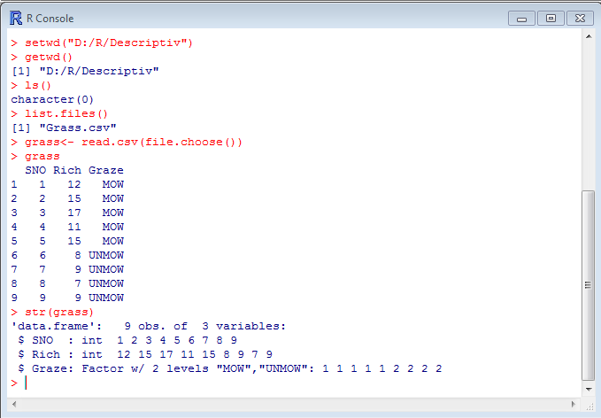
> str(grass)
'data.frame': 9 obs. of 2 variables:
$ rich : int 12 15 17 11 15 8 9 7 9
$ graze: Factor w/ 2 levels "mow","unmow": 1 1 1 1 1 2 2 2 2

Slide 5
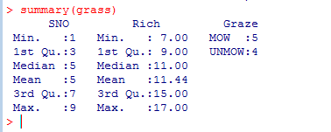
However, the str() command is designed to help you examine the structure of a data object rather than providing a statistical summary. By contrast, the summary() command is designed to give a quick statistical summary of data objects. The output you get depends on the object you are looking at. In this case there is a data frame so each column is summarized:
summary(grass)
Here you see some basic statistics for the numeric column; you can see the largest and smallest valuesas well as central (median and mean) measures. The second column does not contain numbers, so you see a list of the different factors along with a count for each. Here you see five observations for the mow treatment but only four replicates for the unmow treatment.

Slide 6
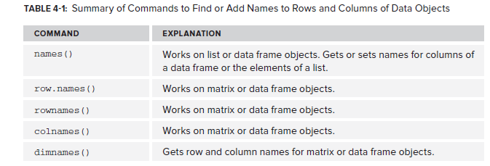

Slide 7
Summary Statistics for Vectors
The simplest data object you will encounter is the vector. A vector is a single column of values—a one-dimensional object. There are a variety of simple summary statistics that can be applied to a vector of numbers, some of which you will meet shortly. In general there are two kinds of summary commands:
➤➤ Commands that produce a single value as a result
➤➤ Commands that produce multiple values as a result
The following sections deal with each of these kinds of summary commands.

Slide 8
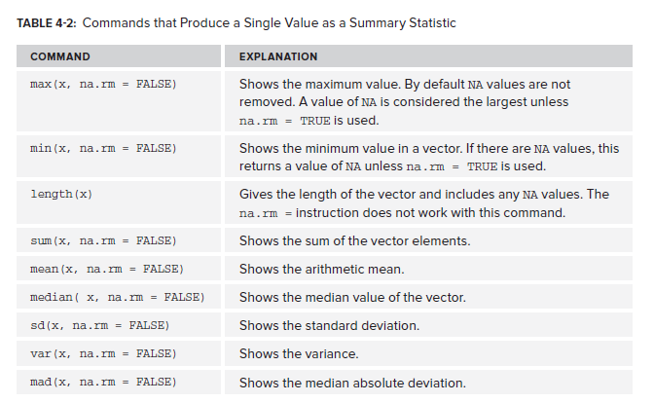
Commands that produce a single value as a result

Slide 9
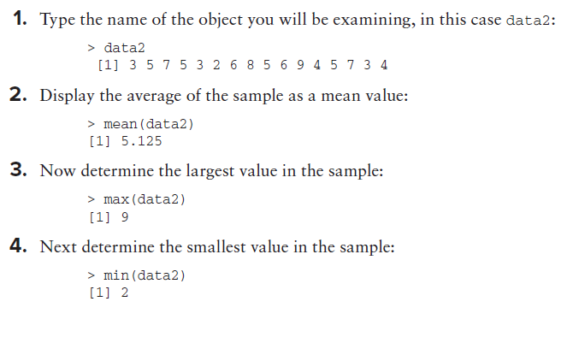
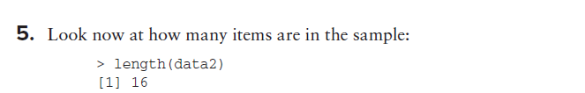

Slide 10
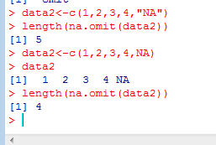
Omitting NA Items
The length() command does not use the na.rm instruction so you need a way to overcome this; fortunately there is a solution. You can use the na.omit() command to strip out NA items. Essentially, you use this to temporarily remove NA items like so:
> length(na.omit(unmow))
[1] 4

Slide 11
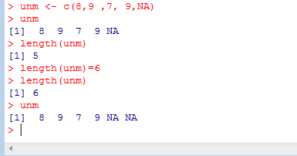
Altering Sample Length
You can use the length() command to alter the length of a vector by setting it to a numeric value. The vector is shortened if your value is less than the current setting. If the setting is longer than the current setting, NA items are added to make it the required length. This can be useful if you want to make a data frame from vectors of unequal length; you can set the length of all vectors to be the same as the longest one:
> unmow
[1] 8 9 7 9 NA
> length(unmow)
[1] 5
> length(unmow) = 4
> unmow
[1] 8 9 7 9
> length(unmow) = 6
> unmow
[1] 8 9 7 9 NA NA

Slide 12
Summary Commands With Multiple Results
data2
[1] 3 5 7 5 3 2 6 8 5 6 9 4 5 7 3 4
> log(data2)
[1] 1.0986123 1.6094379 1.9459101 1.6094379 1.0986123 0.6931472 1.7917595
[8] 2.0794415 1.6094379 1.7917595 2.1972246 1.3862944 1.6094379 1.9459101
[15] 1.0986123 1.3862944
Of course, the log() command is not one you would normally think of as a summary command.
> summary(data2)
Min. 1st Qu. Median Mean 3rd Qu. Max.
2.000 3.750 5.000 5.125 6.250 9.000
> quantile(data2)
0% 25% 50% 75% 100%
2.00 3.75 5.00 6.25 9.00
> fivenum(data2)
[1] 2.0 3.5 5.0 6.5 9.0

Slide 13
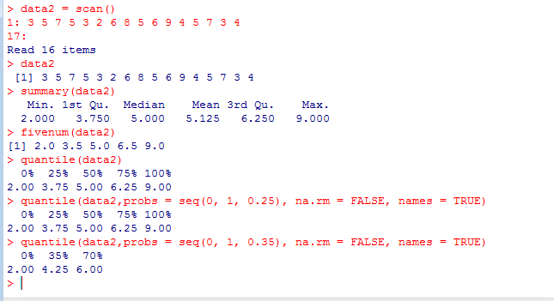
You have already met the basic summary() command. For this simple numeric vector you get two measures of centrality: the mean and median. You also get the extremes as well as the inter-quartile values. The quantile() command shows the quartiles by default; that is, the 0%, 25%, 50%, 75% and 100% quantiles. However, you can select other quantiles. The command allows other instructions as follows:
quantile(x, probs = seq(0, 1, 0.25), na.rm = FALSE, names = TRUE)

Slide 14
The x part is the data object you wish to examine. The probs = instruction enables you to select one or several quantiles to display, defaulting to 0, 0.25, and so on as you saw in the preceding example. This is what the seq(0, 1, 0.25) command is doing; setting a start of 0, an end of 1, and a step of 0.25. This is the same as c(0, 0.25, 0.5, 0.75, 1). The names = instruction tells R if it should display the name of the quantiles produced. In the following activity you examine some of the options for the quantile() command for yourself.

Slide 15
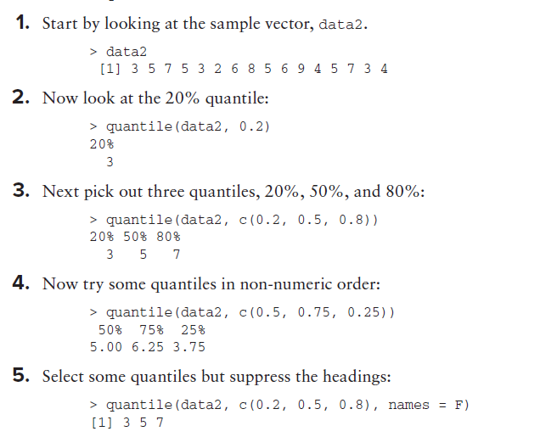

Slide 16
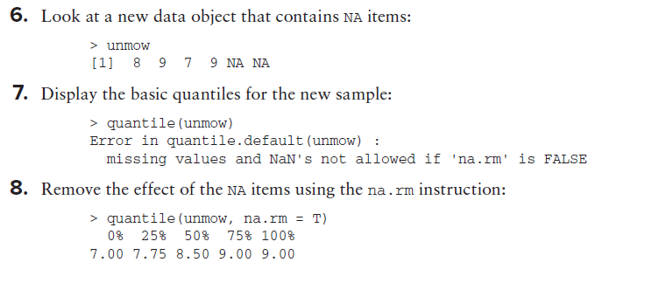

Slide 17
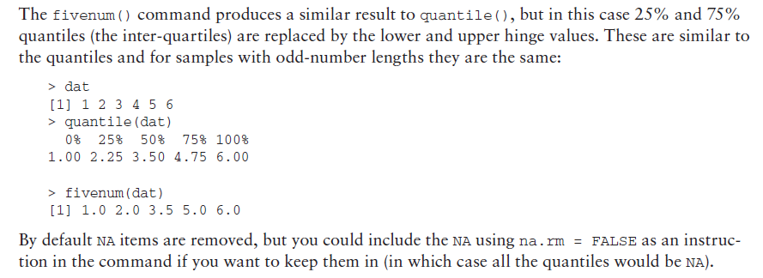

Slide 18
Cumulative Statistics
Cumulative statistics are those that are applied sequentially to a series of values. For example, you may want to track the interest received on an investment. If your data are the interest payments received then the cumulative sum would give you a running total. You can think of the commands that calculate cumulative statistics as being in one of two forms:
➤ Simple cumulative commands
➤ Complex cumulative commands
You will look at both types in this section. Simple commands require only the name of the data object. For complex commands you have to create more complicated instructions to produce the desired result.

Slide 19
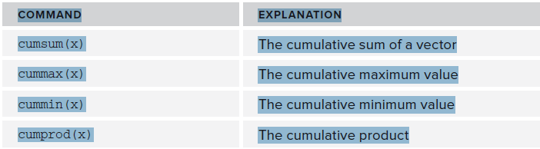
Simple Cumulative Commands

Slide 20
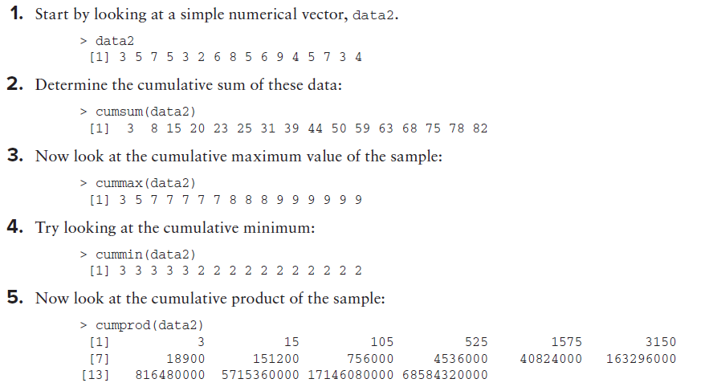

Slide 21
Complex Cumulative Commands
You can use cumulative commands in combination with others to produce additional useful measures; for example, the running mean. The basic arithmetic mean is the sum divided by the number of observations. You can get the cumulative sum, but you also need the cumulative number of observations; you can use the seq() command to help. If you have a sample of numeric values you can create an index like so:
> data2
[1] 3 5 7 5 3 2 6 8 5 6 9 4 5 7 3 4
> seq(along = data2)
[1] 1 2 3 4 5 6 7 8 9 10 11 12 13 14 15 16
In this case you have created a simple index for your sample; you have 16 items. You can also use a “quick” version like so:
> seq_along(data2)
[1] 1 2 3 4 5 6 7 8 9 10 11 12 13 14 15 16

Slide 22
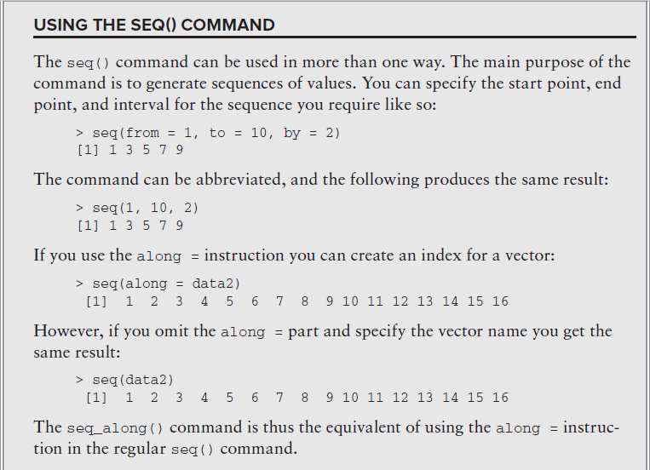

Slide 23
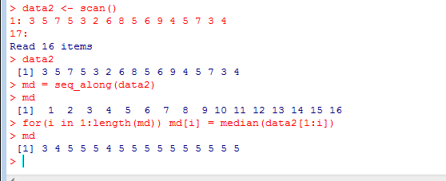
> data2
[1] 3 5 7 5 3 2 6 8 5 6 9 4 5 7 3 4
> md = seq_along(data2)
> md
[1] 1 2 3 4 5 6 7 8 9 10 11 12 13 14 15 16
> for(i in 1:length(md)) md[i] = median(data2[1:i])
> md
[1] 3 4 5 5 5 4 5 5 5 5 5 5 5 5 5 5

Slide 24
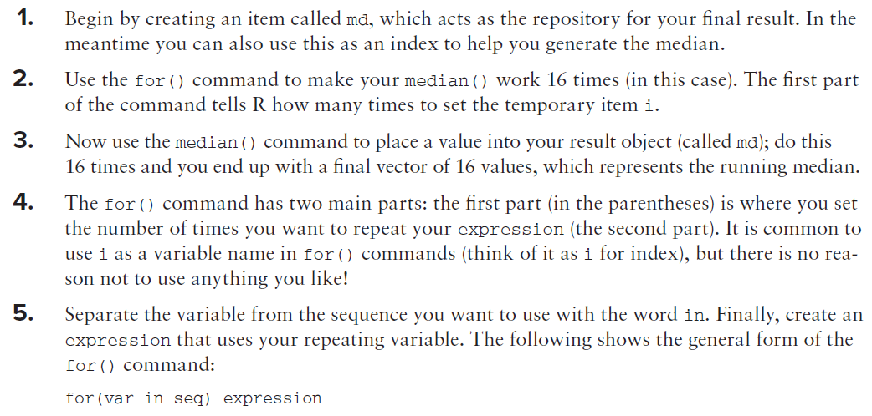

Slide 25
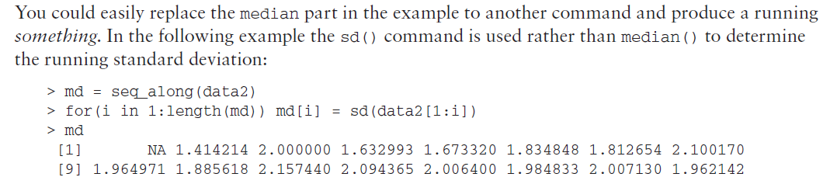
In this example the first item in the result is NA because you cannot calculate a standard deviation of a single value. You look at the for() command again in Chapter 10, where you learn a bit more about customizing functions and creating simple scripts and programming
In this example the first item in the result is NA because you cannot calculate a standard deviation of a single value.

Slide 26
Summary Statistics for Data Frames
So far you have looked to summarize a single vector of data, but there may be times when you want to summarize a more complicated object. Some of the commands you have used already will work on more complex objects, and some need a bit of persuading

Slide 27
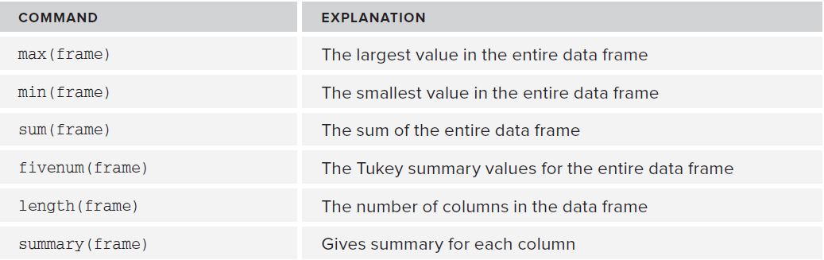
Generic Summary Commands for Data Frames

Slide 28
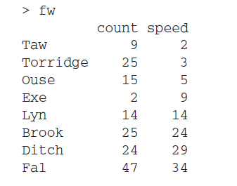
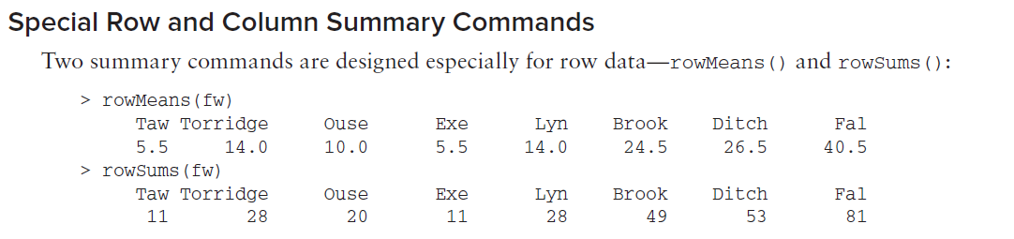

Slide 29
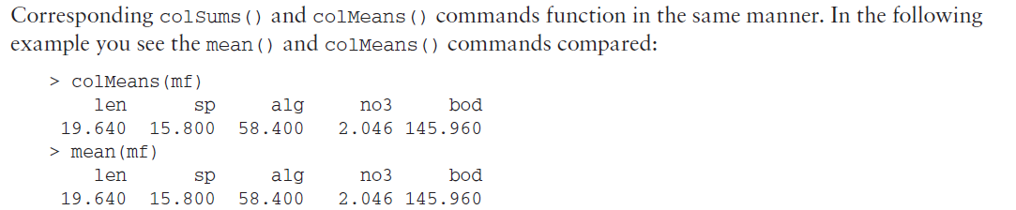
You can see that essentially you get the same display/result. These commands also use the na.rm instruction, and by default this is set to FALSE.
If you want to ensure that NA items are removed, you add na.rm = TRUE as an instruction in the command.

Slide 30
The apply() Command for Summaries on Rows or Columns
The colMeans() and rowSums() commands are designed as quick alternatives to a more general command, apply(). The apply() command enables you to apply a function to rows or columns of a matrix or data frame. The general form of the command is like so:
apply(X, MARGIN, FUN, ...)
In this command the MARGIN is either 1 or 2, where 1 is for rows and 2 is for columns. You replace the FUN part with your command (the function you want to apply) and you can also add additional instructions if they are appropriate to the command/function you are applying. For example, you might add the na.rm = TRUE instruction:

Slide 31
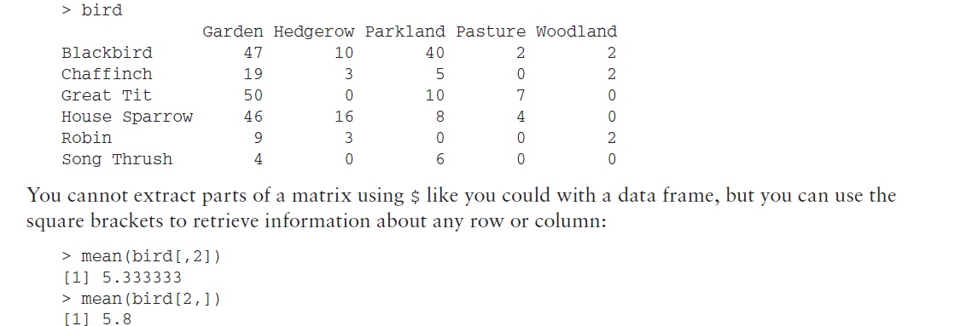
Summary Statistics for Matrix Objects
A matrix looks like a frame but is not; in effect, the data are a single vector that happens to be split into rows and columns. In the following example you see a matrix comprised of some numeric values relating to observations of some common British birds in various habitats:
The first example returns the mean for the second column, whilst the next example returns the mean for the second row. You can also use the colMeans() and rowSums() commands like you used before

Slide 32

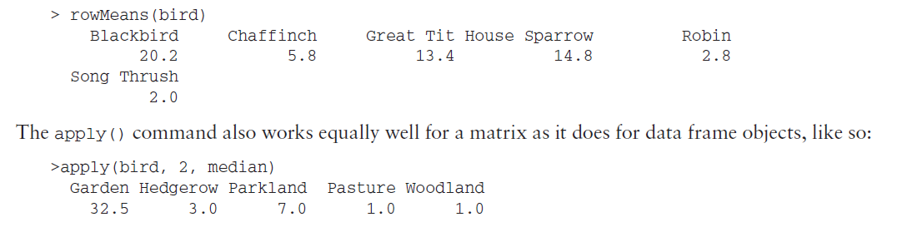

Slide 33
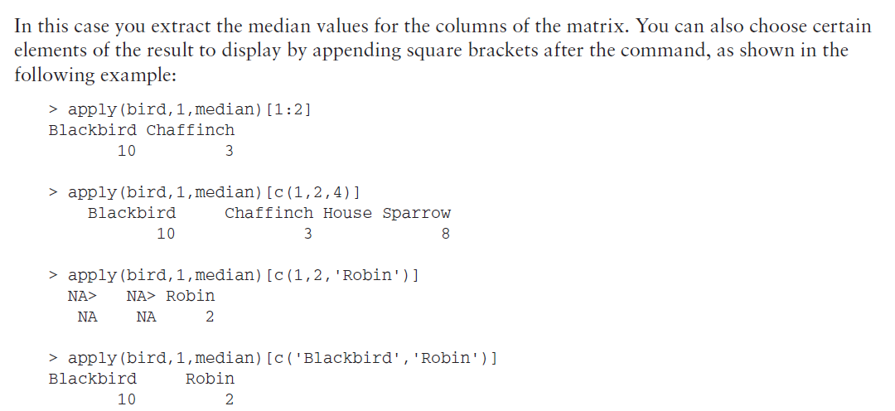

Slide 34
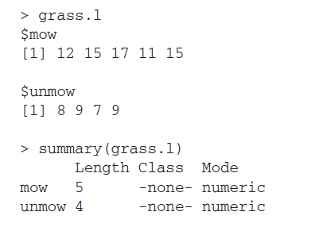
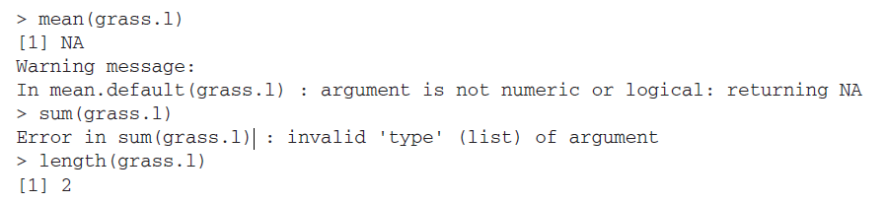
Summary Statistics for Lists

Slide 35
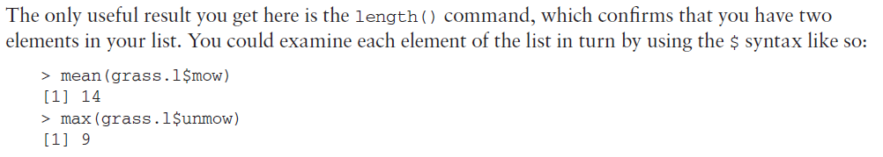
Using $ is fine, but it’s quite tedious if you have more than one or two elements to consider. It is also not generalized enough; it would be better to have a method that did not rely on individual items being named (other than the list object). Instead, you can use a special version of the apply() command that works specifically on list objects. The command is lapply(); think of it as short for “list apply.” This is easy enough to use—you simply name the list and the function you want to apply to each list element like so:
> lapply(grass.l, mean, na.rm = TRUE)
$mow
[1] 14
$unmow
[1] 8.25

Slide 36
You are still able to add extra instructions to the command; in this example you ensure that NA items are removed before the mean() command is applied. The result you get back is in the form of a list pretty much like the original object. You can change this to produce a “nicer” output using a variant of the command sapply() like so.
> sapply(grass.l, mean, na.rm = TRUE)
mow unmow
14.00 8.25
The resulting output is in fact a matrix. This enables you to undertake other manipulations because a matrix object is a bit easier to deal with than a list. If you want to carry out further manipulations on the result, make an object to hold the result:
grass.mn = sapply(grass.l, mean, na.rm = TRUE)
Now you have a new object that can be used later.

Slide 37
Summary Tables
Just as you did with the vector, matrix, list, and data frame objects in earlier , you can manipulate, alter, and produce table objects using the table() command to summarize a data sample. Using this command you can create a few special kinds of table objects, including contingency tables and complex (flat) contingency tables. A contingency table is particularly useful when you have a large number of observations and you want to condense the data into a smaller format. A complex (flat) table is a type of contingency table that is useful when creating just one single table as opposed to multiple ones. Additionally, you can use cross-tabulation to reassemble data into a tabular format as necessary. This section covers how to work with table objects in all of these capacities.

Slide 38
Making Contingency Tables
A contingency table is a way to redraw data and assemble it into a table that shows the layout of theoriginal data in a manner that allows the reader to gain an overall summary of the original data. You can create contingency tables using the table() command. The command can handle data in simple vectors or more complex matrix and data frame objects, as you see shortly. The more complex the original data, the more complex the resulting contingency table will be.

Slide 39
Creating Contingency Tables from Vectors
The simplest data object from which you can create a contingency table is a vector. In the following example you have a simple numeric vector of values:
> data2
[1] 3 5 7 5 3 2 6 8 5 6 9 4 5 7 3 4
> table(data2)
data2
2 3 4 5 6 7 8 9
1 3 2 4 2 2 1 1
Here you use the table() command to organize the data into a simple contingency table. This table shows you how many items in the data match up to the various integer values; you can see that there are three 3s, for example, but only a single 8. You can visualize this better, perhaps, if you rewrite the data in numerical order:
> sort(data2)
[1] 2 3 3 3 4 4 5 5 5 5 6 6 7 7 8 9

Slide 40
Here the sort() command is used to reorder the data values; if you compare this to the table you just created you can see more clearly what the table() command has done. You can use the table() command on character data too; in the following example you have a simple vector of labels:
> graze
[1] "mow" "mow" "mow" "mow" "mow" "unmow" "unmow" "unmow" "unmow"
table(graze)
graze
Mow unmow
4
You can see from the table that there are five items in the mow treatment and four in the unmow treatment.

Slide 41
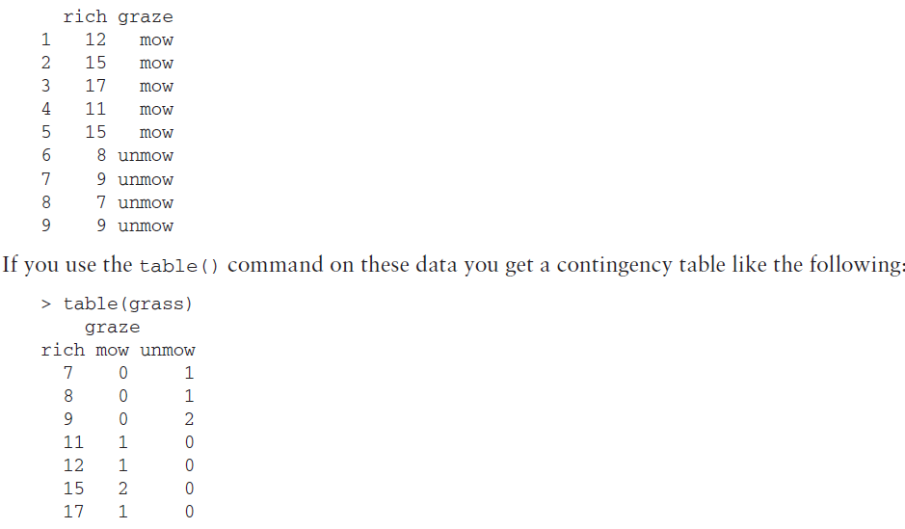
Creating Contingency Tables from Complicated Data
> grass

Slide 42
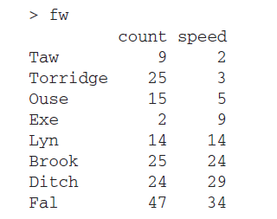
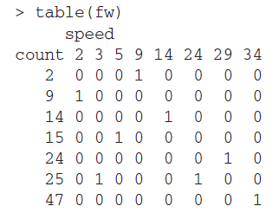
You see the numerical data in the first column, followed by a column for each of the graze treatments. The table shows you how many times a particular numerical value cropped up in each of the graze treatments.
When your data are all numeric you get a more complex table as a result, because each numeric value in the second column is treated as a separate “level” and compared to each value in the first column. In the following example you have a simple data frame that contains two columns of numeric data:

Slide 43
If you have more complex data frames (that is, with more than two columns), you get a more complex result; you end up with multiple tables. Each of the individual tables shows the first two columns in the data frame, but the values in the other columns are picked out one by one with all the various combinations. This can get complicated to say the least. Here is a simple example where you have a data
frame containing a column of numeric values and two columns of factors (character variables):

Slide 44
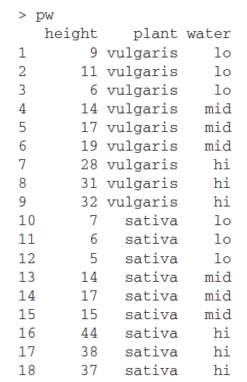
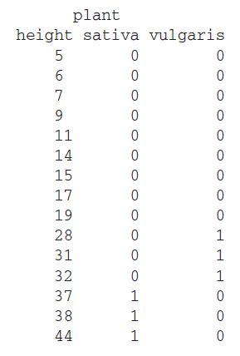
If you use a table() command on these data you get three tables produced as a result. The command
produces a table for each of the water treatments. Here only the first one is shown:
> table(pw)
, , water = hi

Slide 45
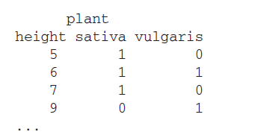
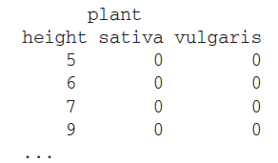
The first table shown examines the situation for the first treatment; the factors are considered in order so the hi treatment comes first (because of alphabetical sorting). The other factors are shown in separate tables; the next one being for the lo treatment:
, , water = lo
Here just the first few lines are shown of the next table in the set. The final table in the example shows the situation when the water treatment is set to mid:
, , water = mid

Slide 46
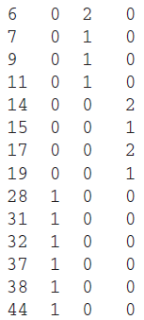
Creating Custom Contingency Tables
Rather than use all the columns (or rows) of a data frame, you could create a contingency table that uses only part of the data. In this situation you can actually select each separate row and column to use, as detailed in the following sections.
> table(pw$height, pw$water)
hi lo mid
5 0 1 0

Slide 47
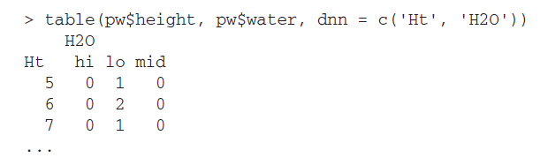
The result is a table that shows you a column for each of the three water treatments. Notice that the names of the items are not given; the height and water labels are gone and you only get the names of the three water treatments. If you had used the attach() command the names would be shown. Of course, there is a way around this; you can use your own labels. To do so, specify the names you require as labels as an instruction in the table() command like so:

Slide 48
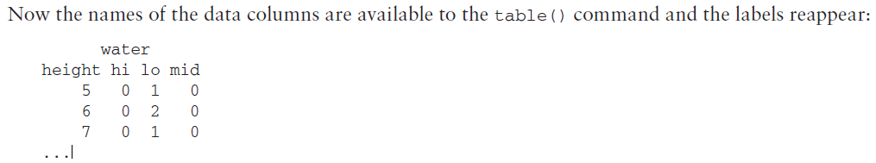
The with() command works in a general manner. To use it you simply put in the name of the data you want to access and then carry on with the command you wanted to use all in the same line, like so:
> with(pw, table(height, water))

Slide 49
Selecting Rows to Use in a Contingency Table
If you want to use only certain rows of a data frame to form the basis for a contingency table, you need to use a slightly different approach. Essentially this involves creating a matrix object and making a contingency table from that.

Slide 50

Stem(data2)
Stem(data2,scale=2)

Slide 51


Random Variables
rnorm(n,mean=0,sd=1)
n is sample number
a<-rnorm(20,mean=0,sd=1)
You can work out probability using the pnorm() command. If you use the same mean and standard deviation as in the preceding code, for example, you might use the following:
A<-pnorm(5,mean=5,sd=1)

Slide 52
In other words, you would expect a value of 5 to be halfway along the x-axis (your result is the cumulative proportion). By performing the following command you can turn this around and work out a value along the x-axis for any quantile; that is, how far along the axis you are as a proportion of its length:
> qnorm(0.5, 5, 1)
[1] 5
hist(data2, freq = FALSE)
data2.norm = rnorm(1000, mean(data2), sd(data2))

Slide 53
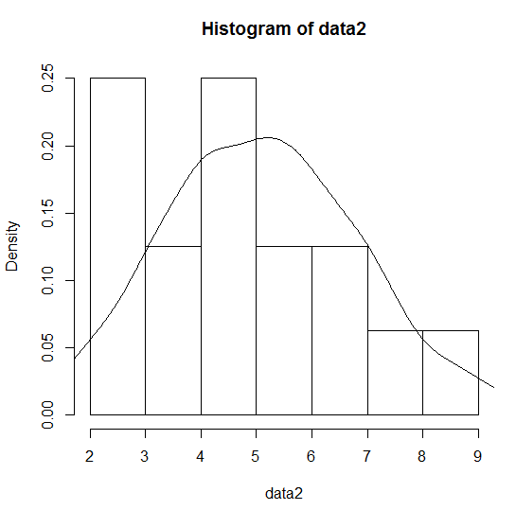
The more values in your distribution the smoother the final graph will appear, so here you create 1000 random numbers, taking the mean and standard deviation from the original data (called data2). You can display the two distributions in one of two ways; you might have the original data as the histogram and the idealized normal distribution as a line over the top, or you could draw the ideal normal distribution as a histogram and have your sample as the line. The following shows the two options:
> hist(data2, freq = FALSE)
> lines(density(data2.norm))

Slide 54
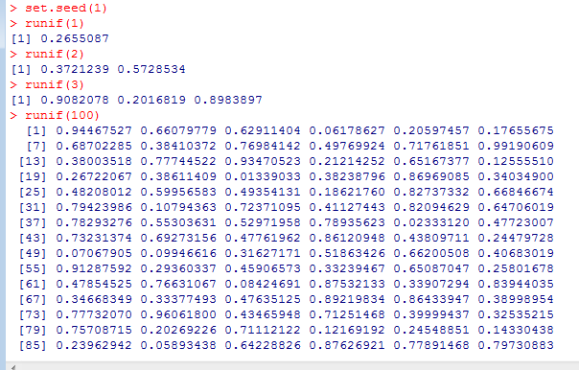
There may be occasions when you are using random numbers but want to get the same random numbers every time you run a particular command. Common examples include when you are demonstrating something or testing and want to get the same thing time and time again. You can use the set.seed() command to do this:
> set.seed(1)
> runif(1)
[1] 0.2655087
> runif(1)
[1] 0.3721239
> runif(1)
[1] 0.5728534
> set.seed(1)
> runif(3)
[1] 0.2655087 0.3721239 0.5728534

Slide 55
Random Numbers and Sampling
> data2
[1] 3 5 7 5 3 2 6 8 5 6 9 4 5 7 3 4
> sample(data2, size = 4)
[1] 3 8 9 6
In this example you extract four of your values as a separate sample from the data2 vector of values. You can do this for character vectors as well; in the following example you have a character vector that comprises 12 months. You use the replace = instruction to decide if you want replacement or not like so:
data8=c("Jan","FEB","MAR","APR","MAY","JUN","JUL","AUG","Sep","OCT","NOV","DEC")
> sample(data8, size = 4, replace = TRUE)
[1] "Apr" "Jan" "Feb" "Oct"
> sample(data8, size = 4, replace = TRUE)
[1] "Feb" "Feb" "Jun" "May"

Slide 56
You can extend this and select certain conditions to be met from your sampled data. In the following example you pick out three items from your original data but ensure that they are all greater than 5:
data2
[1] 3 5 7 5 3 2 6 8 5 6 9 4 5 7 3 4
sample(data2[data2 > 5], size = 3)
[1] 7 9 8
If you leave the size = part out, you get a sample of everything that meets any conditions you have set:
sample(data2[data2 > 5])
[1] 9 8 7 6 6 7
> data2[data2 > 5]
[1] 7 6 8 6 9 7

Slide 57
data3
[1] 6 7 8 7 6 3 8 9 10 7 6 9
sample(data3[data3 > 9])
[1] 1 5 4 7 6 10 3 8 9 2
Because there is only one of them (a 10) you get ten items in your result sample. This is slightly unfortunate but there is a way around it, which is demonstrated in the help entry for the sample() command. You can create a simple function to alter the way the sample() command operates; first type the following like so:
resample <- function(x, ...) x[sample(length(x), ...)]
This creates a new command called resample(), which you use exactly like you would the old sample() command. Your new command, however, gives the “correct” result; the following example shows the comparison between the two:

Slide 58
> data2
[1] 3 5 7 5 3 2 6 8 5 6 9 4 5 7 3 4
> set.seed(4)
> sample(data2, size = 3)
[1] 2 6 7
> set.seed(4)
> resample(data2, size = 3)
[1] 2 6 7
> set.seed(4)
> sample(data2[data2 > 8])
[1] 3 5 2 8 4 7 1 9 6
> set.seed(4)
> resample(data2[data2 > 8])
[1] 9

Slide 59
In this example you use the set.seed() command to ensure that your random numbers come out the same; you use a value of 4 but this is merely a whim, any integer will suffice. At the top you can see that you get exactly the same result when you extract three random items as a sample from your original vector. When you use the sample() command to extract values > 8 you see the error. However, you see at the bottom that the resample() command has given the expected result.

Slide 60
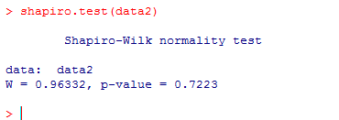
The Shapiro-Wilk Test for Normality
You commonly need to compare a sample with the normal distribution. You saw previously how you could do this graphically using a histogram and a density plot. There are other graphical methods, which you will return to shortly, but there are also statistical methods. One such method is the Shapiro- Wilk test, which is available via the shapiro.test() command. Using it is very simple; just provide the
command with a numerical vector to work on:
> data2
[1] 3 5 7 5 3 2 6 8 5 6 9 4 5 7 3 4
> shapiro.test(data2)
Shapiro-Wilk normality test
data: data2
W = 0.9633, p-value = 0.7223

Slide 61
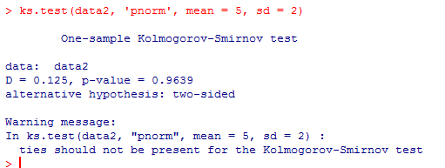
The Kolmogorov-Smirnov Test
The Kolmogorov-Smirnov test enables you to compare two distributions. This means that you can either compare a sample to a “known” distribution or you can compare two unknown distributions to see if they are the same; effectively you are comparing the shape.
The command that allows you access to the Kolmogorov-Smirnov test is ks.test(), which fortunately is shorter than the actual name. You furnish the command with at least two instructions; the first being the vector of data you want to test and the second being the one you want to compare it to. This second instruction can be in various forms; you can provide a vector of numeric values or you can use a function, for example, pnorm(), in some way. In the following example you look to compare a sample to the normal distribution:
ks.test(data2, 'pnorm', mean = 5, sd = 2)

Slide 62
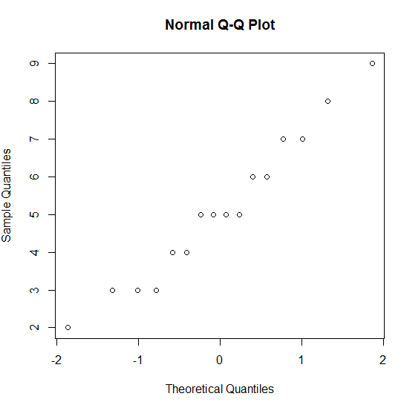
Quantile-Quantile Plots
You have several commands available relating to QQ plots; the first of these is qqnorm(), which takes a vector of numeric values and plots them against a set of theoretical quantiles from a normal distribution. The upshot is that you produce a series of points that appear in a perfectly straight line if your original data are normally distributed. Run the following command to create a simple QQ plot
> data2
[1] 3 5 7 5 3 2 6 8 5 6 9 4 5 7 3 4
qqnorm(data2)
The main title and the axis labels have default settings, which you can alter by using the main, xlab, and ylab instructions that you met previously.

Slide 63
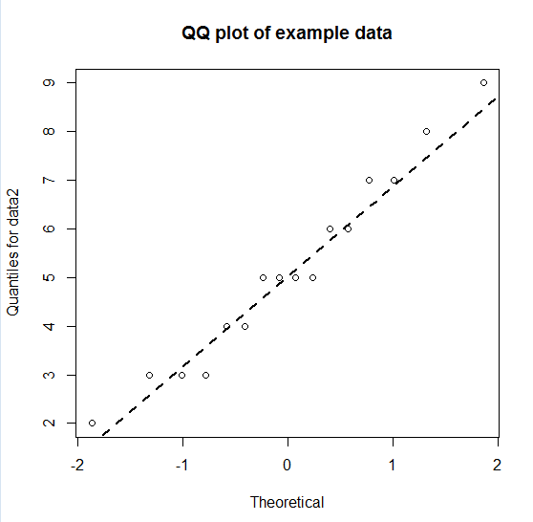
Adding a Straight Line to a QQ Plot
The normal QQ plot is useful for visualizing the distribution because it is easier to check alignment along a straight line than to check for a bell-shaped curve. However, you do not currently have a straight line to check! You can add one using the qqline() command. This adds a straight line to an existing graph.
> qqnorm(data2, main = 'QQ plot of example data', xlab = 'Theoretical',
ylab = 'Quantiles for data2')
> qqline(data2, lwd = 2, lty = 2)

